Slide 1

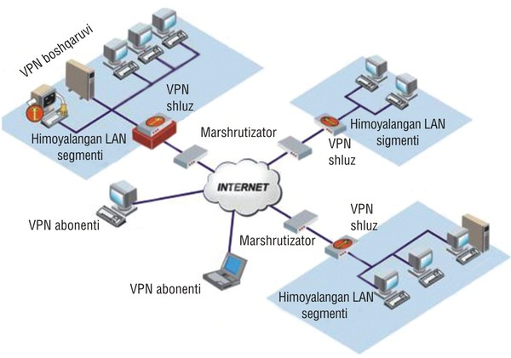
TARMOQ ADMINISTRATORLIGI 28-DARS

Slide 2


UBUNTU OS SERVER MANAGER TOOLS

Slide 3

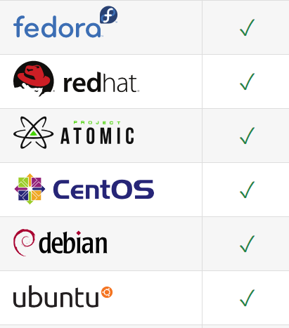


UBUNTU OS SERVER MANAGER TOOLS

Slide 4
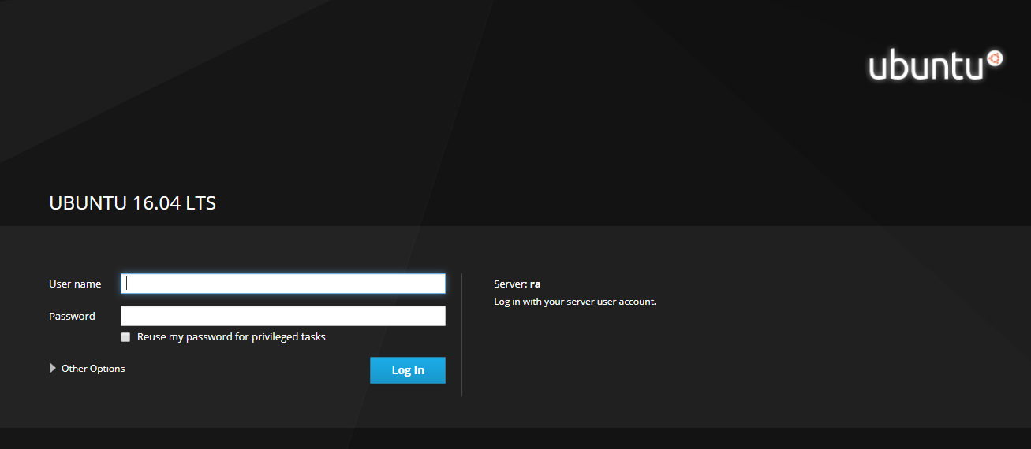
UBUNTU OS SERVER MANAGER TOOLS

Slide 5
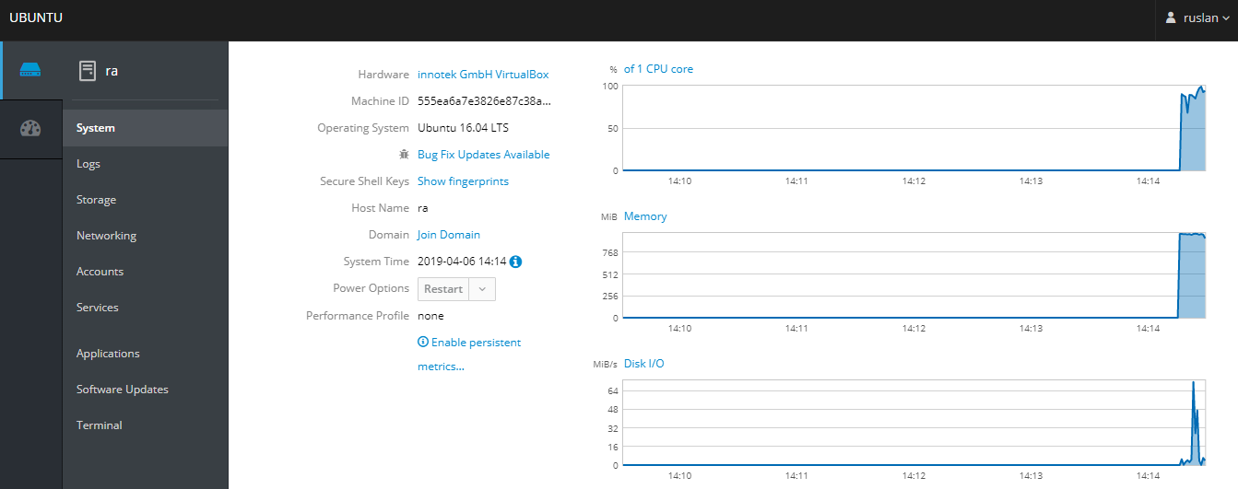
UBUNTU OS SERVER MANAGER TOOLS

Slide 6
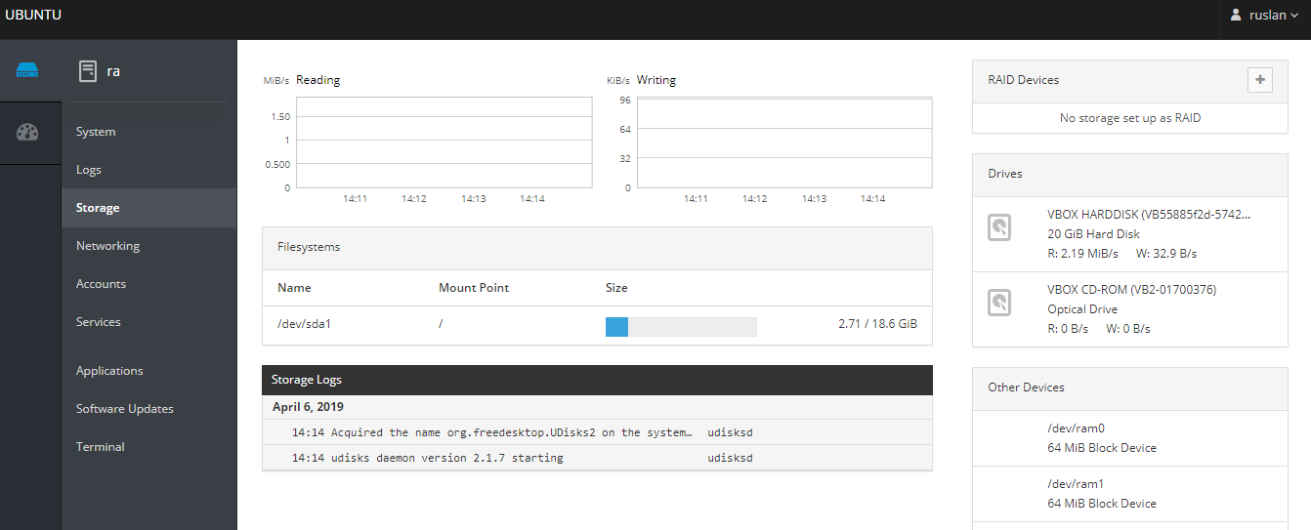
UBUNTU OS SERVER MANAGER TOOLS

Slide 7
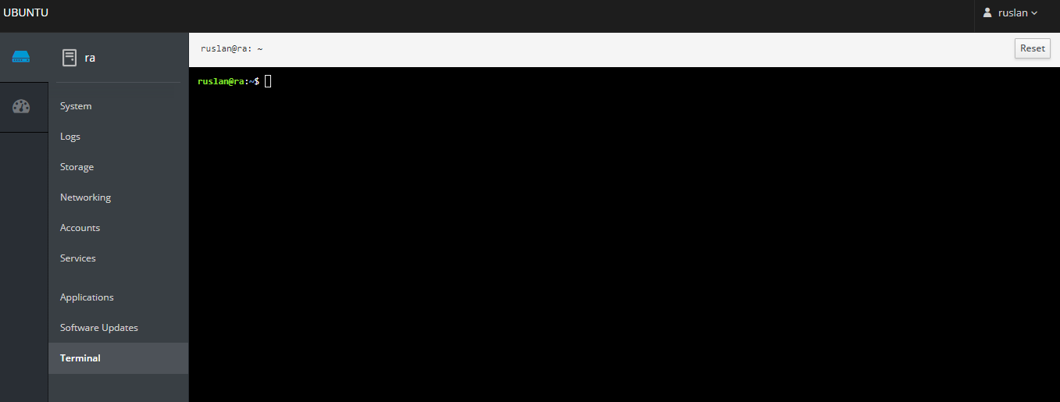
UBUNTU OS SERVER MANAGER TOOLS

Slide 8

UBUNTU OS SERVER MANAGER TOOLS
https://your_domain:10000
sudo nano /etc/apt/sources.list
deb http://download.webmin.com/download/repository sarge contrib
wget http://www.webmin.com/jcameron-key.asc
sudo apt-key add jcameron-key.asc
sudo apt-get update
sudo apt-get install webmin

Slide 9
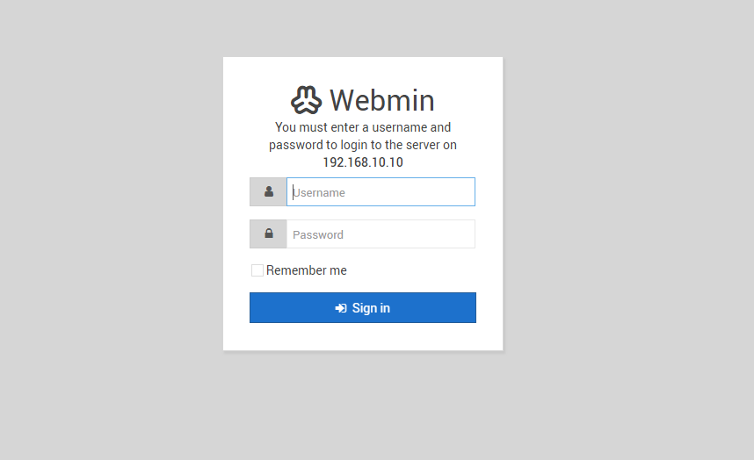
UBUNTU OS SERVER MANAGER TOOLS

Slide 10
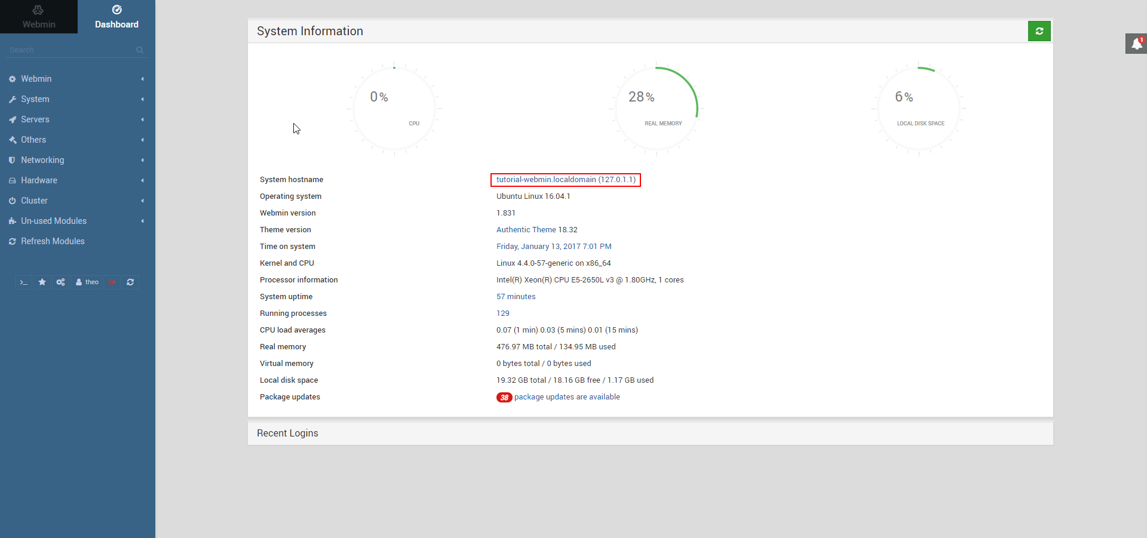
UBUNTU OS SERVER MANAGER TOOLS

Slide 11
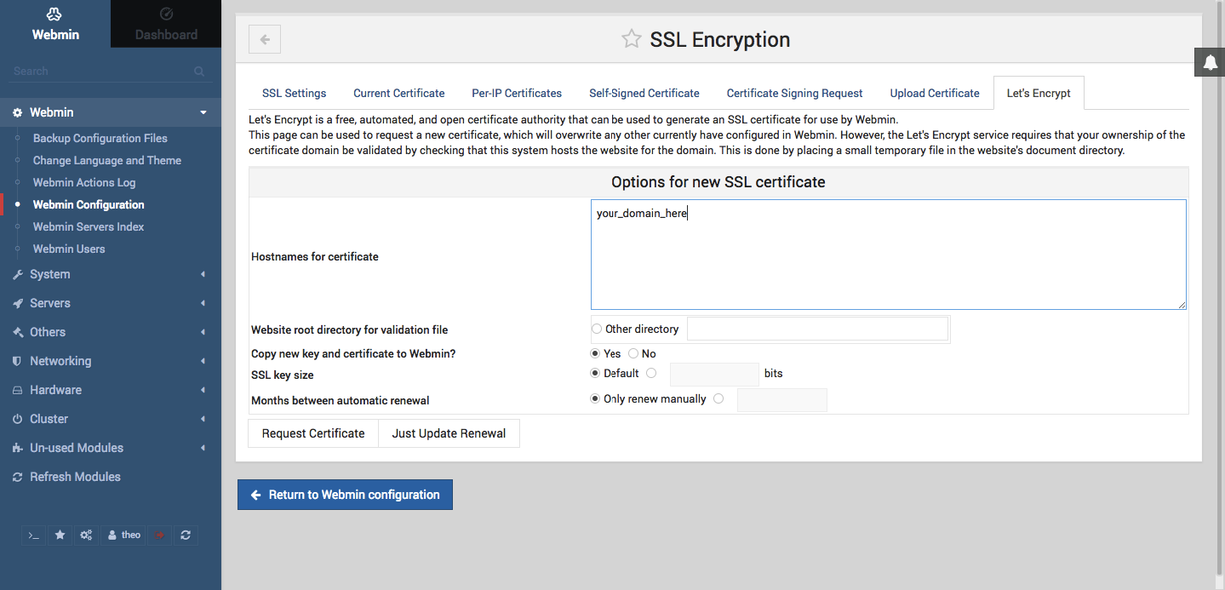
UBUNTU OS SERVER MANAGER TOOLS

Slide 12

UBUNTU OS SERVER MANAGER TOOLS
https://192.168.100.1:8000
Username: root
Password: admin
wget http://repo.ajenti.org/debian/key -O- | sudo apt-key add -
echo "deb http://repo.ajenti.org/ng/debian main main ubuntu" | sudo tee -a /etc/apt/sources.list
apt-get update && sudo apt-get install ajenti
service ajenti restart
sudo systemctl stop ajenti.service
sudo systemctl start ajenti.service
sudo systemctl enable ajenti.service

Slide 13
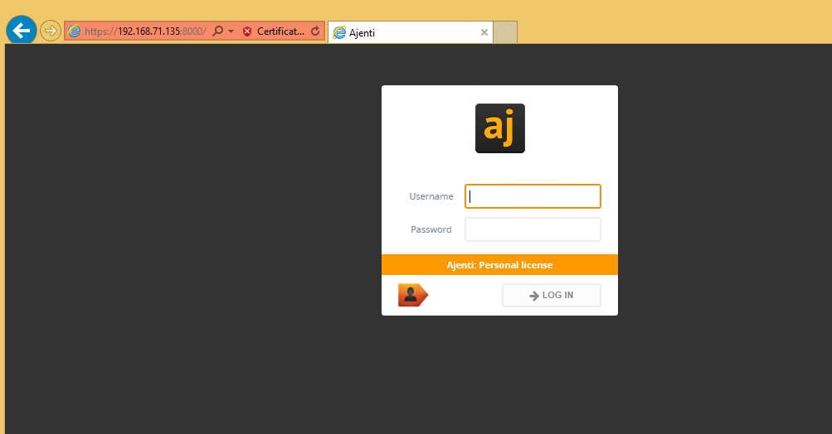
UBUNTU OS SERVER MANAGER TOOLS

